Slide 1
Md. Akibur Rahman Javed
I’m doing B.Sc on Computer Scinence and Engineering at Sheikh Burhanuddin Post Graduate college.

Slide 2
I will present a brief discussion on given topic.
CSS(Cascading style shit)

Slide 3
What is CSS?
CSS stands for Cascading Style Sheets
CSS describes how HTML elements are to be displayed on screen, paper, or in other media
CSS saves a lot of work. It can control the layout of multiple web pages all at once
External stylesheets are stored in CSS files

Slide 4


Slide 5
Why Use CSS?
CSS is used to
define styles for your web pages,
including the design,
layout and variations in display for different devices and screen sizes.

Slide 6
CSS Solved a Big Problem
HTML was NEVER intended to contain tags for formatting a web page!
HTML was created to describe the content of a web page, like:
<h1>This is a heading</h1>
<p>This is a paragraph.</p>
When tags like <font>, and color attributes were added to the HTML 3.2 specification, it started a nightmare for web developers. Development of large websites, where fonts and color information were added to every single page, became a long and expensive process.
To solve this problem, the World Wide Web Consortium (W3C) created CSS.
CSS removed the style formatting from the HTML page!

Slide 7
CSS Saves a Lot of Work!
The style definitions are normally saved in external .css files.
With an external stylesheet file, you can change the look of an entire website by changing just one file!

Slide 8
CSS , How To implement...?
When a browser reads a style sheet,
it will format the HTML document according to the information in the style sheet.

Slide 9
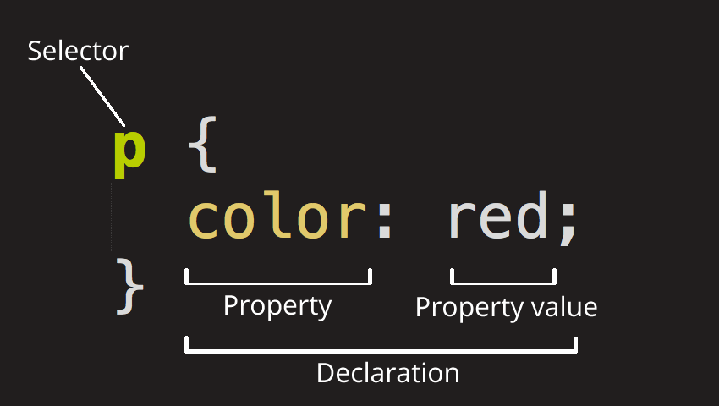
How to write css ?

Slide 10
Three Ways to Insert CSS
There are three ways of inserting a style sheet:
External style sheet
Internal style sheet
Inline style

Slide 11
External Style Sheet
With an external style sheet, you can change the look of an entire website by changing just one file!
Each page must include a reference to the external style sheet file inside the <link> element. The <link> element goes inside the <head> section:
<head> <link rel="stylesheet" type="text/css" href="mystyle.css"> </head>

Slide 12
Internal Style Sheet
An internal style sheet may be used if one single page has a unique style.
Internal styles are defined within the <style> element, inside the <head> section of an HTML page:
<head> <style> body { background-color: linen; } h1 { color: maroon; margin-left: 40px; } </style> </head>

Slide 13
Inline Styles
An inline style may be used to apply a unique style for a single element.
<h1 style="color:blue;margin-left:30px;">This is a heading</h1>

Slide 14
Thank you for listening up me

